Slide 1

Welcome to Brookfield Park Nursery
Miss Walsh – Nursery Teacher
Miss Youssouf – Nursery TA

Slide 2
Starting Nursery
We want to ensure the best possible start for you and your child as we appreciate that starting Nursery is a big step.
Dropping off and picking up
Nursery children will be dropped off Nursery door.
Morning session – 8:55-11:55am
Afternoon session – 12pm-3:10pm
Collection:
11:55am – Front entrance of school
3:10pm – Nursery door.
Please be on time…we start our learning straight away, have meetings after school & our own families waiting for us at home!

Slide 3

Curriculum
The Early Years Foundation Stage Curriculum gives a guidance on what is expected of children by the end of their Reception year.
It is broken down into different age categories, and these are used to help us track each child’s level of level and where any gaps are.
“Whatever life experiences and achievements are to be built on, they need foundations that are rich, broad, varied and robust”.
To access an enriched, broad and balanced curriculum, we highly recommend that your child attends as close to full time as possible.

Slide 4
What is the Foundation Stage?
On Entry to Nursery, children are expected to be working within the 3-4 year old developmental band
There are seven areas of development within the Early Years, these are:
Literacy – reading and writing.
Maths – numbers and shapes.
Expressive arts and design – music, art, design.
Understanding the world – people who help us, animals, our community.
Physical development – fine and gross motor skills, self care.
Personal, social and emotional development – making friends, understanding feelings and learning what the right thing to do is.
Communication and Language – speaking, listening and attention, understanding.

Slide 5
What can you do to help your child as they start at Brookfield Park?
In Nursery, children should mostly develop the 3 Prime areas first:
• Personal, Social and Emotional Development.
• Communication and Language – Talk, Talk, Talk!!!!
• Physical Development

Slide 6


School readiness
In your information pack are two documents from Lancashire county council early years team.
They show the agreed definition of a child being ‘school ready’ – what they are expected to be able to do upon leaving Nursery and joining Reception class.
There is a booklet that helps you to support your child with becoming school ready.
Attending Nursery as much as possible will help massively – we encourage a lot of independence and children in Nursery spend time in our Reception classroom, with the Reception children and their staff too.

Slide 7
Becoming Independent
We encourage the children to become independent from when they first start at Brookfield Park.
When they first start we ask that you assist your child in the morning but not to do everything for them.
We encourage them to hang up their coat, put their book bag & lunch box away.
We do expect children to be toilet trained before they attend Nursery, but we can assist with this stage of development. Can they go to the toilet by themselves?
Can they take their coat, jumper & shoes on & off?
Can they drink from a small plastic glass?
Can they use a spoon?

Slide 8
Daily Routines
Welcome and enter the classroom.
Put our belongings away.
Self Registration, good morning, dinners and days of the week.
Daily phonics and maths activities.
Lunch 11:50am – 12:50pm
Throughout the week, we cover our topic activities through different areas of learning, covering all aspects of the EYFS.
Songs and stories everyday!

Slide 9
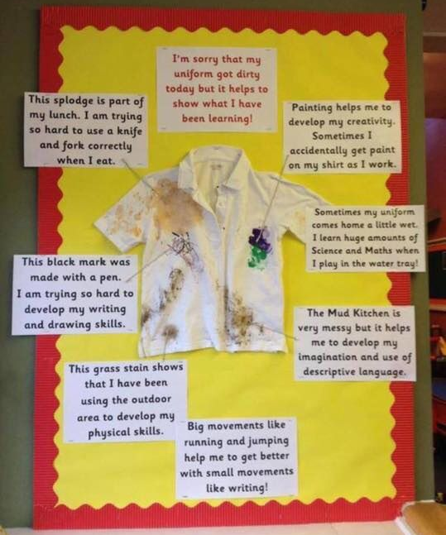
Getting Messy!
…Growing together in faith, love and learning

Slide 10

There are times that your child will need First Aid….
Major & Complex needs – You will need to complete a Health Care Plan.
Allergies – Please inform us of any allergy (even if not likely to be in contact with allergen in Nursery)
Inhalers – You must send one in to be kept in class.
Sun cream must be applied before school.
Medicines – Please complete a request form at the office if you need us to give medicine.
Rashes – We will ask you to get these confirmed by a Doctor or Nurse.
Sickness – Your child Must be kept off for 48 hours from the last episode.
Accidents – Bump letter – MAJOR BUMPS – You will be informed.
Nit Night!!!! Please check your child's hair once a week.

Slide 11


TAPESTRY Online Learning Journal
We use ‘TAPESTRY’, an online learning journal.
We will take photographs and videos to collect as evidence of your child’s special moments in school. We will attach notes to each photograph or video explaining the context and exactly what learning has been demonstrated.
We continue to use this once your child is in Reception class.
All children's assessment records are stored in a secure UK ‘cloud’ which is highly confidential, encrypted and password protected. There will be only you and school who are able to access any of your child’s learning information.
We recommend that you download the Tapestry App to your phone. You can access the information through the Tapestry App on your phone and through your home computer. You will receive details and a consent form to complete before starting Nursery. When your account is active you will receive an email. (This may go to your junk mail).

Slide 12


All About Me
Over the coming days we will send home your child's Nursery journey book- inside there are 2 pages for you to compete with your child all about them. Please allow your children do draw and mark make on these pages and please write to tell us their answers to their favourite things.
Please send this book back into Nursery as soon as you can. Thank you
This gives us a wonderful insight into your child & helps us to
settle them into Nursery.

Slide 13
Reading books & Book bags
Your child will be required to bring a school book bag to Nursery.
You can buy one for £5 at the School Office.
No rucksacks please – send a labelled set of spare clothes inc underwear & socks into school in a plastic bag. These will be kept in school.
If your child wears pull ups, please send a full pack in (labelled again!!) along with a pack of wipes. We will inform you when these are running low.
Your child will receive a story book for you to read to them every week – we can only send these home if you have a book bag.
We will change these weekly, so please send their book bag each time they attend Nursery.

Slide 14


Dinner Time
Hot school lunches are available for children who attend full time, these are £2.70 each. Menus are on our weekly newsletter, or you can send a packed lunch. Free school meals are available for families in receipt of certain benefits- there is a form in your pack if you think you are eligible to claim these.
We ask that children do not bring grapes or any nuts/seeds to Nursery .
Nursery Children who attend either the morning or afternoon session do not need to bring a lunch with them.
At lunch time, Nursery children sit together with Reception class in the small dining room in our school hall. We will inform you at home time if your child has not eaten their lunch. Otherwise, your child is having a happy lunch.
Do not worry if your child does not eat all of their lunch initially. As they learn our lunchtime routines and grow in confidence you will find that they will eat more ☺
Fruit, milk and water are provided for all children at snack time.
Please bring a water bottle every day- please label this with your child’s name.

Slide 15

School Uniform
TOP TIP:
We use a re-uniforming service preloved, good quality uniform, much cheaper. Details on the parents section of our website!!
White polo shirt
Black trousers or black shorts in the Summer
School checked skirt or a green checked summer dress
Purple Sweatshirt or Cardigan with school Logo. Buy a jumper that is big enough for your child to take off & put on by themselves.
Only Velcro shoes – no laces or buckles!!!
White or grey socks, if you choose for your child to wear tights, are they able to pull these up & down independently to use the toilet?
A sun hat for the warmer weather & a warm hat and gloves in the winter.
A pair of black PE pumps, clearly labelled with your child’s name for PE- we will keep these in school.
A warm waterproof coat, as we go outside in all weathers. Please ensure that EVERYTHING is clearly labelled with your child’s name!!!

Slide 16



And Finally…
If you have any worries or concerns please email us to arrange to speak to the Nursery Teacher.
Our email address is nursery@brookfieldpark.lancs.sch.uk
In the morning you can give any messages to the Teacher at the door, such as anyone different who will be picking up your child.
We look forward to working with you and your child throughout their Nursery Journey
Please keep up to date with Nursery information on our web page.

