Slide 1

Welcome to
Brookfield Park Primary School
Welcome to Hazel Class
Nurture, include and inspire to succeed’

Slide 2

Our Brookfield Park Promise
We are kind
We are resilient
We take ownership
_____
‘Nurture, include and inspire to succeed’
Our Ethos, Vision and Mission Statement can be found on our website
www.brookfieldparkprimary.co.uk

Slide 3
Communication
A weekly newsletter will be emailed to you.
You will also receive emails and text messages as needed.
Class Newsletters will be emailed to you each half-term
Each class has an email address to contact the class teacher (see next slide). You may also need to contact the school office.
Social Media (please do not use social media platforms if you have concerns as it is detrimental to your child’s school. Contact us instead please).
bursar@brookfieldpark.lancs.sch.uk
Please keep your details up to date with the school office.

Slide 4
Communication
Should you wish to speak to your child’s class teacher, we ask that you use the class email to contact them (hazel@brookfieldpark.lancs.sch.uk). I am sure you appreciate that it is difficult for class teachers to speak to parents at the beginning and the end of the day as in the morning they will be in class preparing and when they are dismissing their classes after school they need to ensure that all children have left safely and often have meetings to get to. You can give a message to the staff member on the door if you like and this will be passed to the class teacher or you can email to make an appointment if you wish to speak to them face to face.
Please also be aware that class teachers may not respond to emails straight away. Staff will not respond to emails after 5pm or on a weekend but they will respond to you as soon as possible.
At Brookfield Park Primary we pride ourselves on building positive relationships with parents and we ask that you speak to staff in a courteous and respectful way.

Slide 5
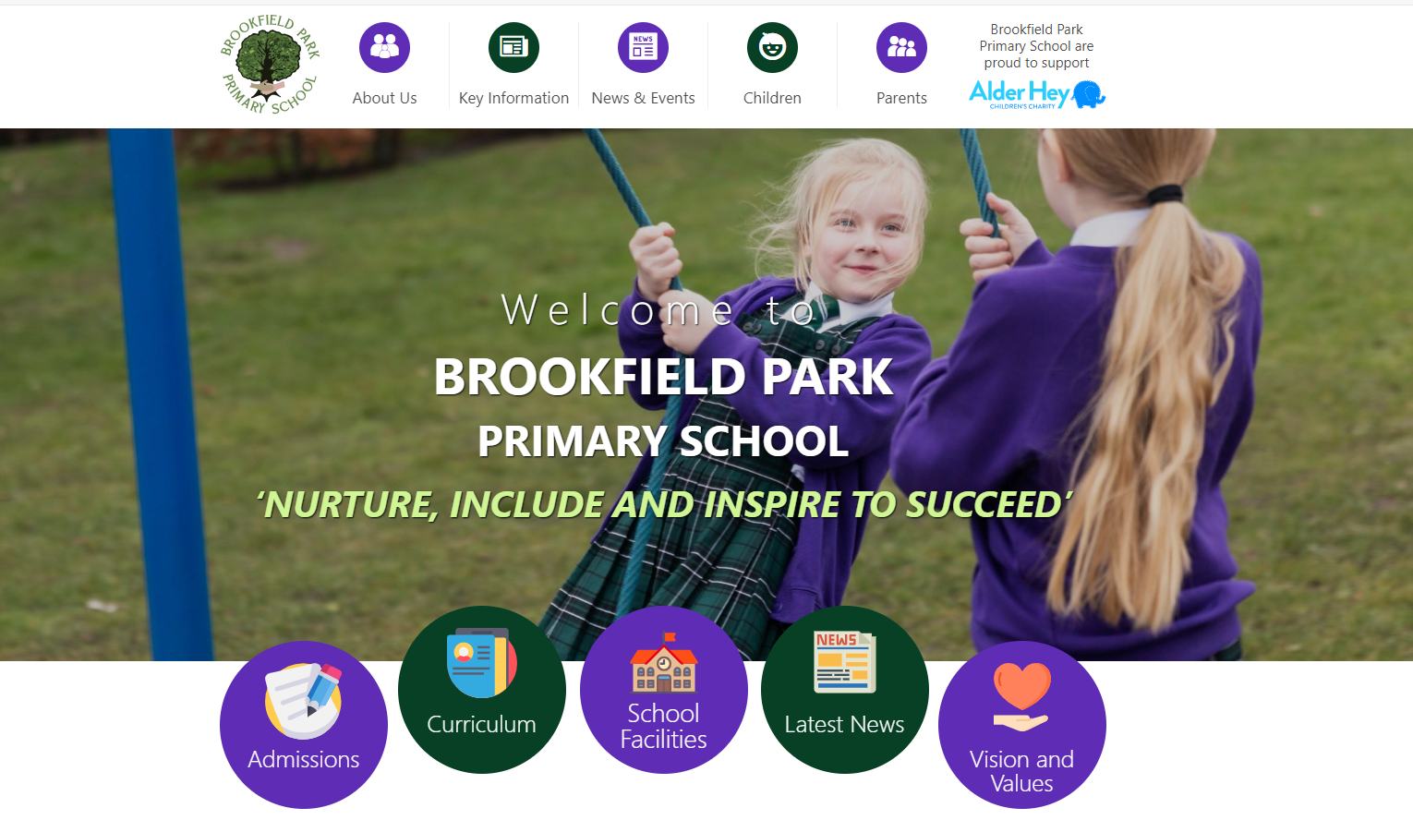
School Website https://www.brookfieldparkprimary.co.uk/

Slide 6
School Website
In the Children section you can find our Hazel class page
On the class page there are sections on:-
Letters
Homework
Reading
Learning links
Photographs
You will also find much more information in other sections such as Parents and Key Information including our curriculum for all subjects.

Slide 7
Reading
Children will be taking home a book they choose themselves and also one from our Twinkl phonics reading scheme/book bands.
We ask parents to listen to your child read regularly and ask them questions to develop their comprehension skills. Questions/prompts are being sent home to help with this discussion.
Books will be changed regularly (see class information slide)
Our aim is to support children to develop all the necessary skills for reading and to develop their love of reading.
Please date and make a comment in their reading record book.

Slide 8

Phonics
The children will take part in a Twinkl phonics session each day. Please see the parent information sheet for further information.
Any children who did not pass the phonics check in Year 1 will receive extra phonics intervention in Year 2. They will then do the phonics re-check in June.
Any children who did not then pass the phonics re-check at the end of Year 2 will receive extra phonics support in Year 3.

Slide 9
Spelling
Spellings for Year 2 will be sent home every Monday to practise with parents/carers for a test on Friday.
They have a daily spelling session linked with their phonics.
Spelling strategies (see information in your pack)

Slide 10
Mathematics
Reception to Y6 children are taught mathematics using the White Rose Maths Scheme (version 3). Year 2
Further information is available with these links.
https://whiteroseeducation.com/parent-pupil-resources/maths
https://whiteroseeducation.com/parent-pupil-resources/maths/free-downloads
The calculations policy and further information can be found in the Key Information Curriculum Mathematics Section of the school website.
Children in Reception, Years 1 and 2 also have a daily NCETM Mastering Number session. The aim is for all children to leave KS1 with fluency in calculation and a confidence and flexibility with number.
In Year 4 the children take a national Multiplication Tables Check to assess their times tables knowledge.

Slide 11
TT Rock Stars and Numbots
All children in Years 1 to 6 have their own individual username and password to access this at home and at school.
TT Rock Stars supports times table recall in Years 2 to 6. Numbots is particularly important to develop understanding and recall of number bonds in Years 1 to 2. As part of their ongoing homework pupils are expected to regularly access TT Rock Stars (Years 2 to 6) and Numbots (Year 1 and 2)
We monitor their use and a certificate is awarded to a member of each class on a Friday in our Pupil of the Week assembly.

Slide 12
SEN Support
GRADUATED RESPONSE TO SEND
At Brookfield Park Primary School we have clear procedures for the identification of and provision for pupils with SEND. These procedures are based on a Graduated Response as outlined in the SEND Code of Practice (2015).
We are committed to improving outcomes for ALL children and we believe that ALL pupils should have access to a broad and balanced curriculum. We have high aspirations for every pupil whatever their prior attainment or SEND status.

Slide 14

As part of this commitment all children are given access to Quality First Teaching. This means that they have:
• Access to the full school curriculum (for identified SEND pupils this is achieved by the careful differentiation of class work by the class teacher)
• All pupils are monitored by class teachers to identify children falling significantly below the expected range of academic and non-academic attainment.
• The SENDCO may be consulted and may observe and offer advice if appropriate
• The teaching and learning for all pupils is regularly reviewed and access to a range of strategies to support vulnerable children.
• Parents will be informed regularly of their child’s development via termly reports or parent’s meetings and are encouraged to share information they may have. We ask that parents request for school to be copied in to correspondence from hospital, GP/paediatrician and other agencies.
• Teachers have regular Pupil Progress meetings with their Team Leader to monitor and assess the progress of individual children.
If following this, school feel that a pupil has needs that are additional or different from that provided as part of the class differentiation, that pupil will be placed on the school SEND register at school support.

Slide 15

School Support
• The class teacher devises interventions additional to or different from those provided as part of the school's differentiated classroom provision. This will be detailed in their individual learning plan which will be shared with parents
• Pupils may be assessed using PIVATS (Performance Indicators for Valued Assessment and Targeted Learning) This allows the teacher to set clear targets and track small steps of progress.
• The pupil and parents are informed and involved at this stage.
• The class teacher remains responsible for the pupil's education on a daily basis and for planning any interventions required and reviewing their leaning plan
• The class teacher and SEND Co-ordinator (SENDCo) monitor and review the pupil's progress termly.
During this stage if any additional support from outside agencies is required the SENCO and class teacher, in consultation with parents will complete the necessary referral for support.

Slide 16

Request for Specialist Support
Children needing specialist support will be discussed as part of the pupil progress review with the Senior Leadership team on a termly basis.
Pupils may be discussed with the school’s link EP and an action plan devised. Permission will be sought from parents before this happens.
Following the referral, support will be provided by an outside specialist (waiting times can be quite long but you will be advised by the SENCO of the possible time involved)
Additional or different strategies to those at ‘School Support’ are put in place.
Recommendations from specialists are included in the learning plan
The pupil and parents are involved in regular reviews of their learning plan.
The class teacher and SENDCo assess and monitor the pupil's needs and plan future interventions as part of an ongoing process.
This is all part of gathering evidence as a graduated response to support for pupils who are identified with SEND. If a pupil has been on SEN Support and has had considerable input from school and other educational professionals as part of the graduated response, and they continue to demonstrate severe, long-term and complex needs, the school may consider an EHCP request.

Slide 17
Assessment and Reporting to Parents/Carers
Ongoing assessment takes place in every lesson and at the end of units of work.
At the end of each term we use teacher assessment and formal assessments to track your child’s progress in Phonics (EYFS, KS1), Reading, Writing and Mathematics.
Other assessments take place to monitor progress in other subjects in the curriculum.
A short report will be sent home at the end of the Autumn term and a longer more detailed report is sent home at the end of the Summer term.
We hold a Parents evening (either in person/ or virtual as requested) in the Spring term. Appointment letters will be sent home in advance.

Slide 18
Y2 Optional Assessments
In 2024, Key Stage 1 SATs are no longer compulsory national tests. However, KS1 SATs have been 'replaced' by optional KS1 SATs tests.
Y2 children will take non-statutory optional assessments at the end of the year.

Slide 19
Attendance
Pupils should attend school every day. Each week the class with the highest attendance receives the attendance trophy.
Parents/carers should contact school if your child is ill and unable to attend. Pupils should not be off with only minor ailments.
It is school policy to contact parents/carers to find out the reason your child is absent. Holidays will not be authorised during term time (see school term dates). There are some exceptional circumstances.
A form will need to be completed and returned to school. There needs to be at least 2 weeks notice if you feel you have an exceptional circumstance you would like to be considered. If you give less than 2 weeks notice it will definately be unauthorised in line with government policy and a fine is highly likely to be issued.
Please download the Studybug app for you to inform school of a reason for absence.

Slide 20
Other important class information
Homework days:-
Phonics parent information sheets are on the class webpage for your information.
Y2 phonics homework will be sent out on a Monday and should be returned by Friday .
TT Rockstars (Year 2) /Numbots (Year 2) at least 10 minutes per night
Times tables test (x2 x5 x10 initially) on a Friday for Year 2 pupils
Reading every day or at least 4 times a week please.
PE day(s): Monday and Thursday
(Hair up and jewellery off or plasters for covering needed please)
Uniform reminder

Slide 21
Thank you for your support
Any Questions?

