Slide 1

Welcome to
Brookfield Park
Primary School
Welcome to Willow Class
Nurture, include and inspire to succeed’

Slide 2

Our Brookfield Park Promise
We are kind
We are resilient
We take ownership
_____
‘Nurture, include and inspire to succeed’
Our Ethos, Vision and Mission Statement can be found on our website
www.brookfieldparkprimary.co.uk

Slide 3
Communication
A weekly newsletter will be emailed to you.
You will also receive emails and text messages as needed.
Our Class Newsletter will be found on the Willow class website page on our school website on Friday.
Each class has an email address to contact the class teacher willow@brookfieldpark.lancs.sch.uk
You may also need to contact the school office
bursar@brookfieldpark.lancs.sch.uk
Please keep your details up to date with the school office to ensure that you do not miss anything.

Slide 4
Communication
Should you wish to speak to your child’s class teacher, we ask that you use the class email to contact them ( willow@brookfieldpark.lancs.sch.uk). I am sure you appreciate that it is difficult for class teachers to speak to parents at the beginning and the end of the day as in the morning they will be in class preparing and when they are dismissing their classes after school they need to ensure that all children have left safely and often have meetings to get to. You can give a message to the staff member on the door if you like and this will be passed to the class teacher or you can email to make an appointment if you wish to speak to them face to face.
Please also be aware that class teachers may not respond to emails straight away. Staff will not respond to emails after 5pm or on a weekend but they will respond to you as soon as possible. Anything URGENT for that day please speak to the office or morning member of staff on the doors.
At Brookfield Park Primary we pride ourselves on building positive relationships with parents and we ask that you speak to staff in a courteous and respectful way.

Slide 5
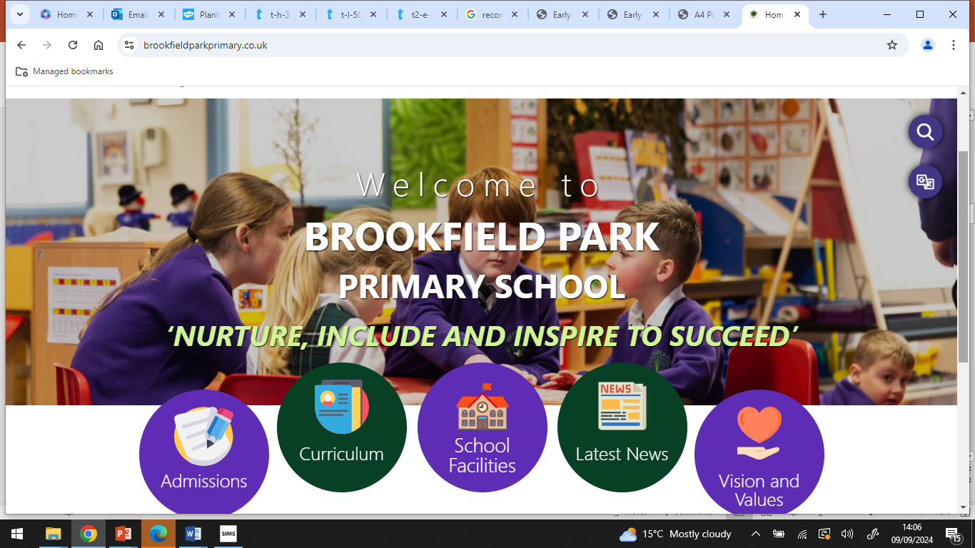
School Website https://www.brookfieldparkprimary.co.uk/

Slide 6
School Website
In the “Children” section you can find our Willow class page
Our class page will be updated regularly and there will be sections on:-
Letters
Homework
Reading
Learning links
Photographs
You will also find much more information in other sections such as Parents and Key Information including our curriculum for all subjects.

Slide 7
Reading
Children this term will take home a book that they choose themselves – we are always updating the books in our reading garden
We ask parents to encourage your child to read regularly and ask them questions to develop their comprehension skills. Questions/prompts can be found in your packs.
Book will be changed as the children complete a book and complete a book review too – all to be recorded into their Reading Journals.
Our aim is to support children to develop all the necessary skills for reading and to develop their love of reading.

Slide 8
Spelling
In Years 3, 4, 5 and 6 children have daily spelling sessions. Spellings will be sent home every Monday to practise with parents/carers for a test on Friday.
They have a daily spelling session – each day practising a different skill.
See the class web page for spelling resources information and some suggested strategies that could be used at home.

Slide 9
Mathematics
Reception to Y6 children are taught mathematics using the White Rose Maths Scheme.
Further information is available with these links.
https://whiteroseeducation.com/parent-pupil-resources/maths
https://whiteroseeducation.com/parent-pupil-resources/maths/free-downloads
The calculations policy and further information can be found in the Key Information Curriculum Mathematics Section of the school website.
TT Rockstars should be practised at home and a weekly times tables test will take place on a Friday.

Slide 10
SEN Support
GRADUATED RESPONSE TO SEND
At Brookfield Park Primary School we have clear procedures for the identification of and provision for pupils with SEND. These procedures are based on a Graduated Response as outlined in the SEND Code of Practice (2015).
We are committed to improving outcomes for ALL children and we believe that ALL pupils should have access to a broad and balanced curriculum. We have high aspirations for every pupil whatever their prior attainment or SEND status.
PLEASE REFER TO SEND DOCUMENT ON OUR CLASS WEBPAGE FOR MUCH MORE DETAILED INFORMATION AND PROCEDURES – AVAILABLE AS SOON AS UPDATED.

Slide 11
Assessment and Reporting to Parents/Carers
Ongoing assessment takes place in every lesson and at the end of units of work.
At the end of each term we use teacher assessment and formal assessments to track your child’s progress in SPAG, Reading, Writing and Mathematics.
Other assessments, SATS practice take place to monitor progress in other subjects in the curriculum.
A short report will be sent home at the end of the Autumn term and a longer more detailed report is sent home at the end of the Summer term.
We hold a Parents evening (either in person/ or virtual as requested) in the Spring term. Appointment letters will be sent home in advance.

Slide 12
Y6 SATS
KS2 Year 6 SATs Dates – May 2024
Monday 12th May 2025 – Grammar and Punctuation Test – 45 mins
Spelling test – 20 minutes
Tuesday 13th May – English Reading Test – 60 minutes
Wednesday 14th May – Maths Arithmetic (Paper 1) – 30 minutes
Maths Reasoning (Paper 2) – 40 minutes
Thursday 15th May – Maths Reasoning Paper (Paper 3) 40 minutes
Writing Moderation will take place in June and data entered will be towards the end of June
July – KS2 SATs results will be released by external examiners – date TBC

Slide 13
Attendance
Pupils should attend school every day. Each week the class with the highest attendance receives the attendance trophy.
Parents/carers should contact school if your child is ill and unable to attend. Pupils should not be off with only minor ailments.
It is school policy to contact parents/carers to find out the reason your child is absent. Holidays will not be authorised during term time (see school term dates). There are some exceptional circumstances.
A form will need to be completed and a meeting held with Headteacher Mrs Sarah-Jane Whiteside. 2 weeks notice is needed feel you have an exceptional circumstance like to be considered. Poor attendance and there is a chance you will be fined, or if no notice - in line with government policies that we are required to follow.
Please download the Studybug app for you to inform school of a reason for absence – really quick and can do anytime e.g. middle of night and will only alert us in the morning.

Slide 14
Other important class information
Homework days:-
Maths and Spelling is set on a Monday and is due in on a Friday.
PE day(s):- Autumn Term – up until Christmas…
Thursday and Friday - PE
Summer Term – the children will go swimming

Slide 15
Many thanks you for your continued support.
Any further questions please contact me via email, message at the door or office.
Thank you for your time.

